Slide 1
UNIT-4
The Statistical Basis of Thermodynamics
The Macroscopic & the Microscopic States
Contact between Statistics & Thermodynamics: Physical Significance of the Number Ω(N,V,E)
Further Contact between Statistics & Thermodynamics

Slide 2
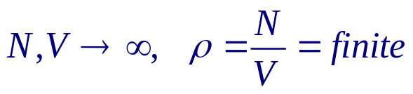
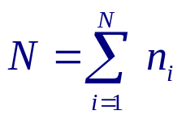
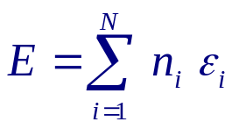

1.1. The Macroscopic & the Microscopic States
System of N identical particles in volume V, with
(Thermodynamic limit )
E.g., Non-interacting particles:
ε_{i} = single particle energies
n_{i} = # of p’cles with energy ε_{i}
A macrostate is specified by parameters ( N, V, E, ... ).
Postulate of equal a priori probabilities:
All microstates satisfying the macrostate parameters are equally likely to occur.
Let
= # of all microstates that give rise to the
macrostate (extensive) parameters N, V, E, ... .

Slide 3
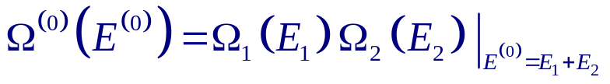
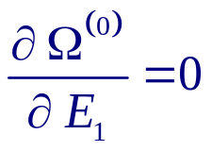
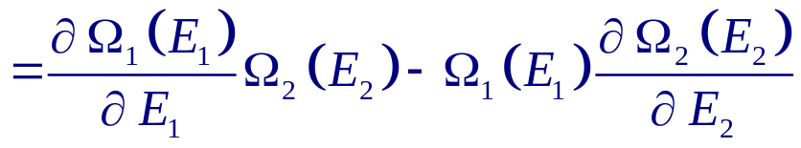
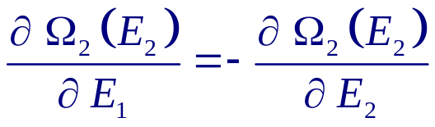
1.2. Contact between Statistics & Thermodynamics: Physical Significance of the Number Ω(N,V,E)
Consider 2 systems A₁ & A₂ in thermal contact with each other,
i.e., partition is fixed, impermeable but heat conducting.
( N_{j} , V_{j} & E⁽⁰⁾ = E₁ + E₂ are fixed )
⁽⁰⁾ denotes properties of the composite system
A₁
( N₁ , V₁ , E₁ )
A₂
( N₂ , V₂ , E₂ )
→
Equilibrium is achieved if E₁ ( with E₂ = E⁽⁰⁾ − E₁ ) maximizes Ω⁽⁰⁾ :

Slide 4
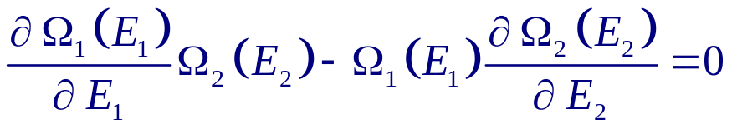
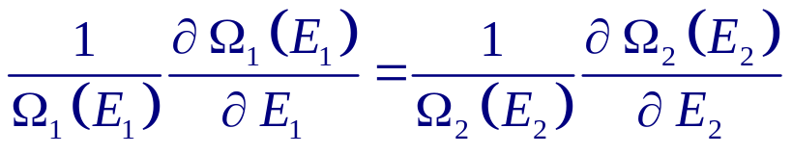
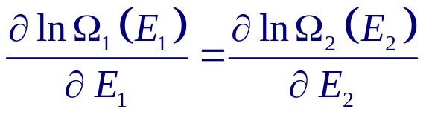
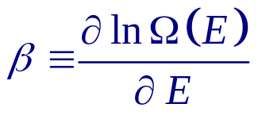
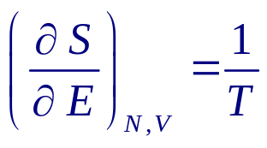

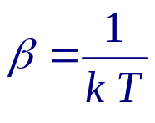

→
→
  2 systems are in thermal equilibrium
  if they have the same β .
Let
Thermodynamics :
Boltzmann :
k = Boltzmann constant
→
→ 0th law ( thermal eqm.)
Planck :
→ 3rd law

Slide 5
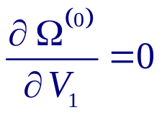
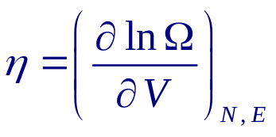

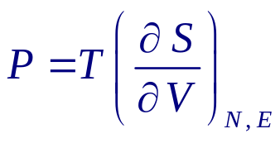
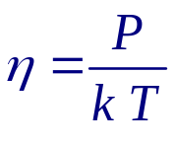
1.3. Further Contact between Statistics & Thermodynamics
For an impermeable but movable & heat conducting partition, N_{j} , V⁽⁰⁾ = V₁ +V₂ & E⁽⁰⁾ = E₁ + E₂ are fixed.
Equilibrium is achieved, i.e., Ω⁽⁰⁾ is maximized, if
and
i.e., both system have the same values of β &
1st law:
μ = chemical potential
→
→
~ mech. eqm.

Slide 6
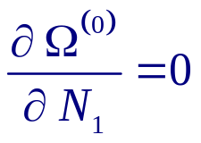
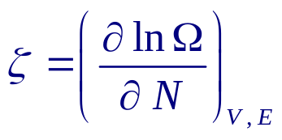
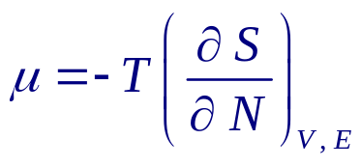
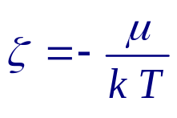
For a permeable, movable & heat conducting partition,
N⁽⁰⁾ = N₁ + N₂ , V⁽⁰⁾ = V₁ +V₂ & E⁽⁰⁾ = E₁ + E₂ are fixed.
Equilibrium is achieved, i.e., Ω⁽⁰⁾ is maximized, if
i.e., Both system have the same values of β, η, &
1st law:
→
→
~ chemical eqm.

Slide 7
Summary
Connection between statistical mechanics & thermodynamics is
Once Ω is written in terms of the independent thermodynamical variables,
all other thermodynamic quantities can be obtained via the Maxwell relations.

